Slide 1
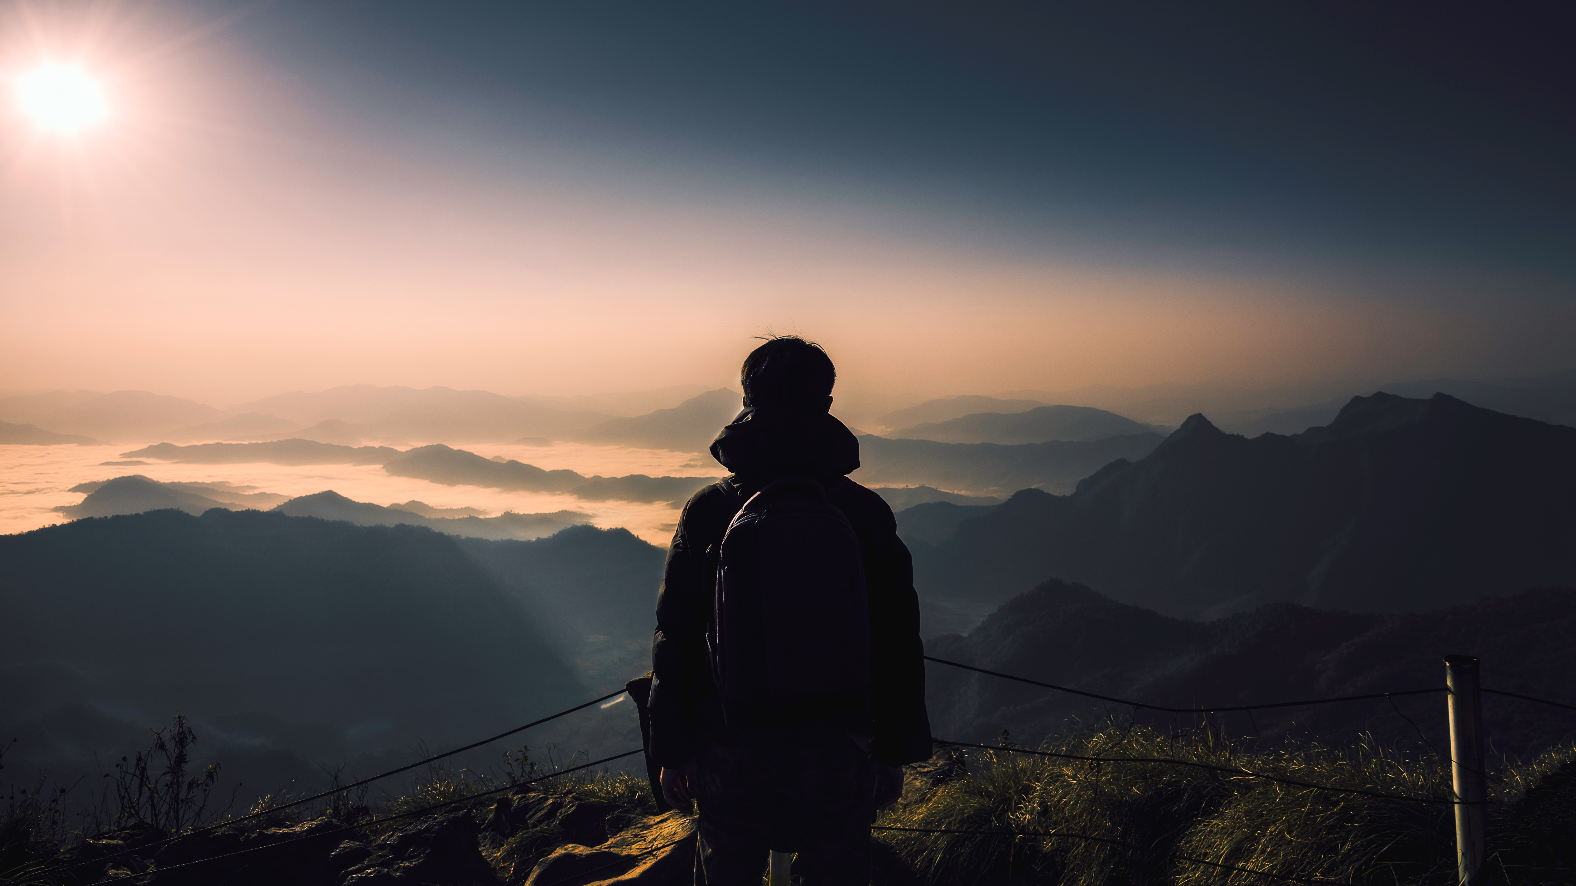
Travel Experts
Group 3:
The better way to enjoy your world
Notes:
Tim

Slide 2

Our Team
Matthew MacMaster
Tim Leslie
COLIN
LEE-CHEE
Ibraheem Kolawole
Notes:
(transition in) Tim → Ibraheem → Matthew → Colin (transition out)
Backend communication → layout and style → Functionality → Task scheduler

Slide 3



Our goal for the customer experience
To provide a web service to your clients to allow them to find information on your products for purchase.
Allow customer to browse travel packages for more information
1
Allow customers to register their information with your company
2
Allow customers to book packages online
3
Notes:
Colin

Slide 4
Our goal for your business
To provide a web service for your agency to enhance your current business model.
Allow agents to manage the website for internal business requirements
1
Allow agent to control current bookings.
2
Build toward the additional functionality
3
Notes:
Tim
2) Business decision to keep control of cancellations (client needs to contact agency)

Slide 5
Scope/ limitations create an easy to use system to store business information to identify marketing opportunities by the end of the first quarter (April). Develop the commission tracking system by end of the second quarter (June) Our base software package is $200,000. Additional features will be $15,000 per feature.
Prototype Proposal
Active launch
Identify marketing opportunities
Track commission
Service
Feb
March
April
May
June
Notes:
Matthew

Slide 6

Why Hire Us?
Our website allows autonomous updating for the increasing needs for your customers.
We can build towards your business needs to allow for flexible reporting
We can provide active implementation of the website immediately
Notes:
Colin

Slide 7

Demo
Here is free time for you to look at the prototype and ask questions
Notes:
Ibraheem

